Slide 1
Patterns of Household Purchase of OTC Hydrocortisone
Presented by Valentine J. Ellis, MBA
Consumer Research Manager
GlaxoSmithKline Consumer Healthcare
March 24, 2005

Slide 2
Research Objectives
Understand purchase patterns in the OTC hydrocortisone (“HC”) category among U.S. households (“HH’s”)
  Data on household purchasing as a proxy for annual household usage
  Likely an overestimation of usage

Slide 3
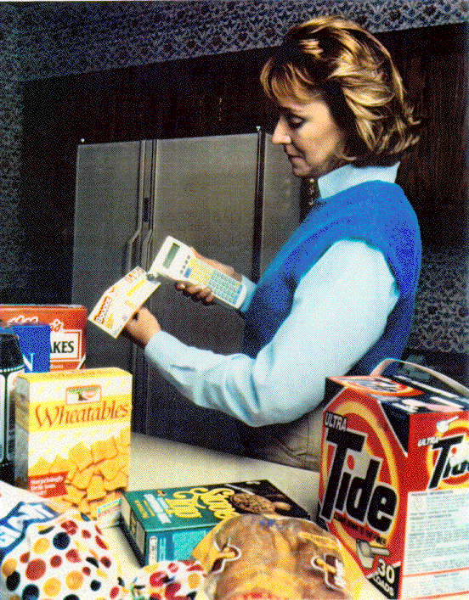
Methodological Detail
AC Nielsen Household Panel
  n=55,000
  geographically & demographically representative of US census
Panelists scan UPC “bar codes” for all personal purchases
  no focus on specific products
  transmit once per week
Incented with non-biasing “frequent flyer” type point program

Slide 4
Custom Analysis
Hydrocortisone category (as defined by ACNielsen):
  Cortaid, Cortizone and HC store brands, OTC products only
Time Period:
  52 weeks ending October 19, 2002
Measures:
  Buying households
  Buy rate (ounces, purchases)

Slide 5
Custom Analysis
Sample = HH’s that scanned any HC product during the time period
Buyer Groups:
  Total Buying Households
  Households with No Children
  Households with Children <18

Slide 6
Methods
Strengths:
  Ongoing electronic tracking of actual purchase behavior
  Objective reporting of all purchases
Limitations:
  Household level purchase data, e.g., not linked to individual user(s).
  Detailed data on usage (conditions treated, frequency, duration) not collected

Slide 7
Key Findings
Annual household purchasing of OTC hydrocortisone products is limited
  13% of total US HH’s purchase
    75% of buying HH’s purchase one time per year
    90% of total buying HH’s purchase 5 ounces or less
Households with children buy less volume per year than HH’s without children

Slide 8
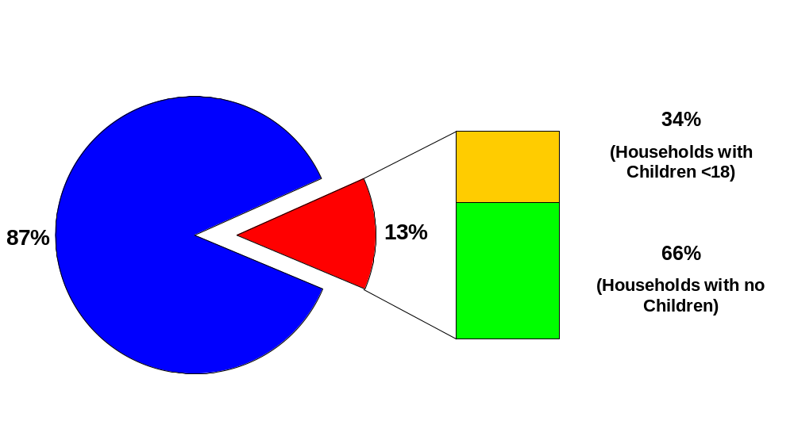
OTC HC Purchase Patterns and Demographics
13% of total US HH’s purchase OTC HC
Presence of children demographic consistent with total US census
ACNielsen Homescan Panel Analysis, 52 weeks ending 10/2002

Slide 9
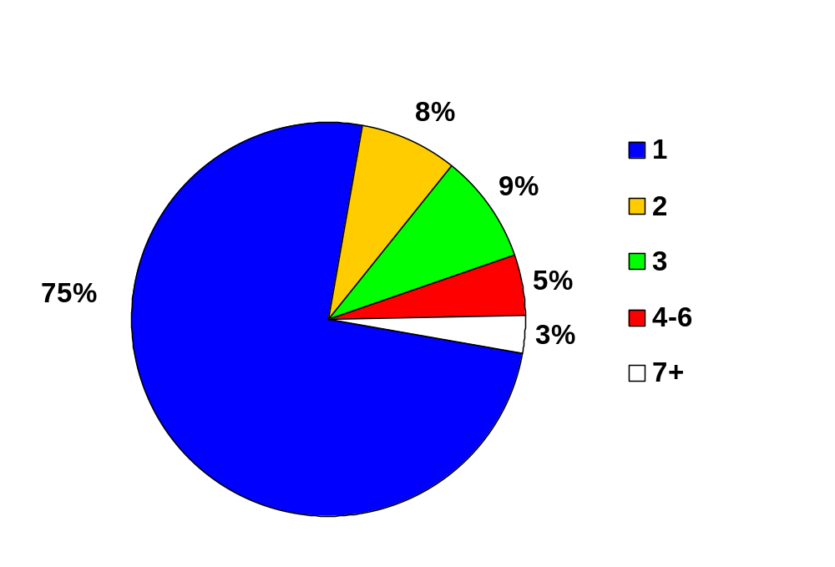
Number of Purchases Per Year
75% of households make only one purchase per year
92%
ACNielsen Homescan Panel Analysis, 52 weeks ending 10/2002

Slide 10
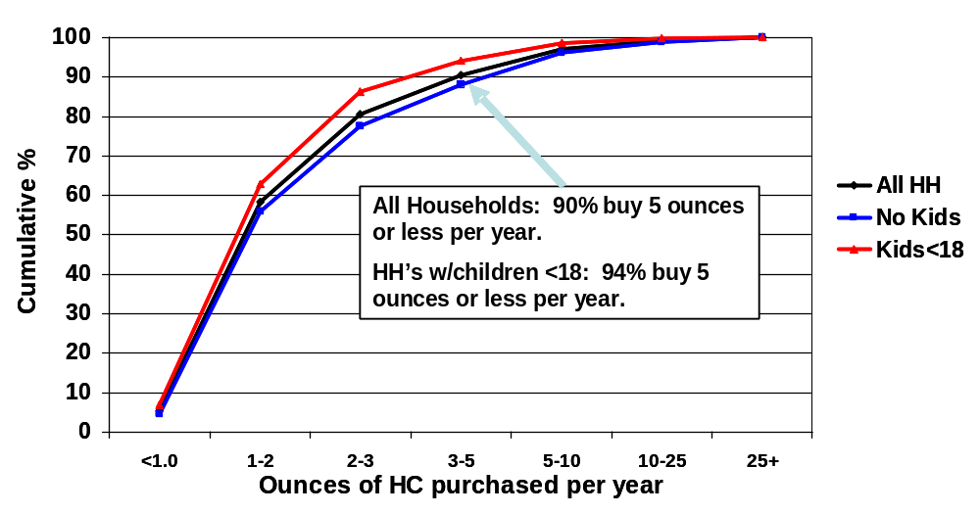
Annual Purchase Volume by Demographic
ACNielsen Homescan Panel Analysis, 52 WE 10/2002

Slide 11
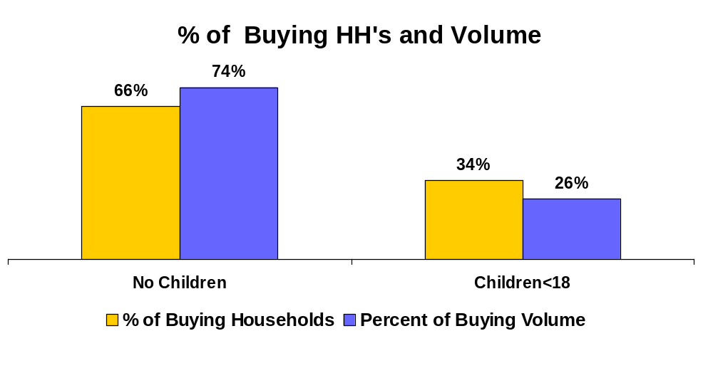
HC Buying Households and Volume
HC buying households with children are lighter buyers than their childless counterparts.
ACNielsen Homescan Panel Analysis, 52 WE 10/2002

Slide 12
Conclusions
Annual household purchasing of OTC hydrocortisone products is limited
  13% of total US HH’s purchase
    75% of buying HH’s purchase one time per year
    90% of total buying HH’s purchase 5 ounces or less
Lower purchase volume in HH’s with children
Based on the amounts purchased, excessive use of OTC topical corticosteroids is probably not an issue.

Slide 13
Back-Up Slides
#14 – HH Purchase Behavior ’01, ’02, ’03
#15 – Race & Ethnicity Detail

Slide 14
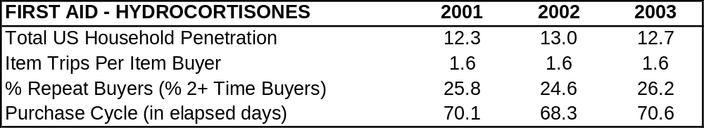
Household Purchase Behavior
Household purchase patterns are consistent over time.
ACNielsen Homescan Panel, Consumer Facts 2001, 2002, 2003

Slide 15
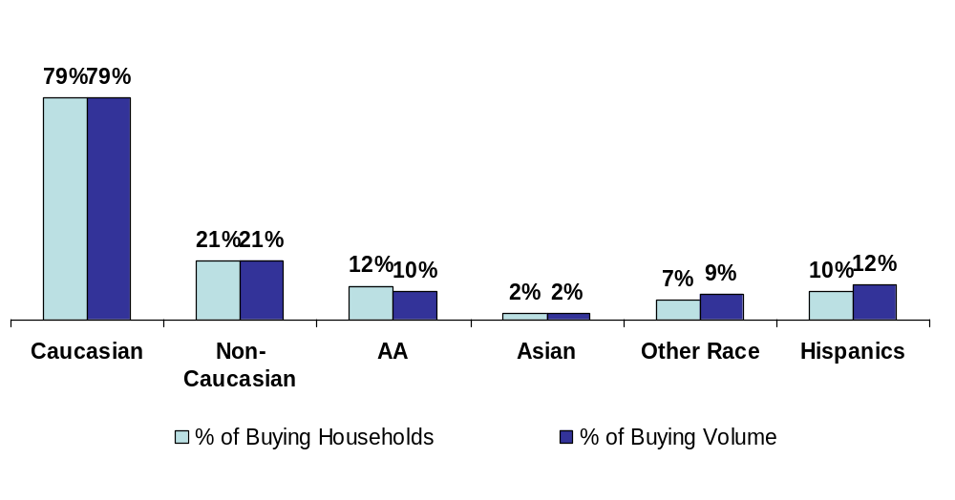
Race/Ethnicity Detail
HC purchasing is slightly heavier among Hispanics.
ACNielsen Homescan Panel, Consumer Facts 2002

